Slide 1
WP2: Development of competence-based curricula aligned with EU trends
Haris Skoulikaris, Panagiotis Prinos
Aristotle University of Thessaloniki
Kick-Off Meeting, Nis, Serbia/ 21-12-2018
This project has been funded with support from the European Commission. This publication reflects the views only of the author, and the Commission cannot be held responsible for any use which may be made of the information contained therein.

Slide 2
WP2: Development of competence-based curricula aligned with EU trends
A new developed competence-based master and strengthening of existing master curricula, in line with EU trends.
Definition of
teachers’ competencies,
learning outcomes,
course content and
syllabi.
Within WP2 the WB teaching staff will be trained in EU partner countries for implementation of innovative teaching methods in the field of WRM.
Each of the WB HEIs will define the local working group which will be responsible for strengthening master curricula. Working groups will be under the supervision and control of the Project Management Committee.
All preliminary reports and defined curricula will be prepared and analysed on the meetings and their short descriptions will be presented to the Steering Committee for the final review and approval.
Strengthening of master curricula in water resources management
for the Western Balkans HEIs and stakeholders
www.swarm.ni.ac.rs

Slide 3
WP2: Development of competence-based curricula aligned with EU trends
The courses that will be used in defining master curricula in WB partner countries will be developed and learning materials will be prepared.
Special responsibility of partners from EU countries is to ensure a modern and innovative approach in the creation of learning materials and teaching methodology.
Since substantial differences among the curriculums of partner HEIs and different national conditions related to accreditation exist, adaptation to national frame of developed master curricula will be necessary.
Strengthening of master curricula in water resources management
for the Western Balkans HEIs and stakeholders
www.swarm.ni.ac.rs

Slide 4
WP2: Development of competence-based curricula aligned with EU trends
The WP2 is subdivided into five activities:
A2.1 Development of specific competencies and learning outcomes of curricula in WB
A2.2 Development of courses content and syllabi
A2.3 Innovation of existing and development of new master curricula for WRM in WB
A2.4 Accreditation of master curricula
A2.5 Theme-based training of teaching staff for acquiring new teaching and learning methods
A2.6 Purchasing of literature, software and laboratory equipment
Strengthening of master curricula in water resources management
for the Western Balkans HEIs and stakeholders
www.swarm.ni.ac.rs

Slide 5
WP2: Development of competence-based curricula aligned with EU trends
A2.1 Development of specific competencies and learning outcomes of curricula in WB
Catalogue of competencies as a base for development competence-based curricula in the field of WRM will be concentrated on two types of competencies: 1) generic and 2) subject-specific. The main task is precisely identification of common competencies for all curricula defined by WB HEIs.
A2.2 Development of courses content and syllabi
At least 15 up-to-date courses related to water management topics will be developed and assembled in referent document for master curricula in WRM - SWARM unique set of courses.
Strengthening of master curricula in water resources management
for the Western Balkans HEIs and stakeholders
www.swarm.ni.ac.rs

Slide 6
WP2: Development of competence-based curricula aligned with EU trends
A2.3 Innovation of existing and development of new master curricula for WRM in WB
Developed syllabi of master curricula will consist of course description, course objectives (course outcomes), course methodology, grading criteria, grade computation, course policies and attendance taking in account measurable objectives.
Catalogue of courses for each newly developed curriculum in WB HEIs will be presented in the Report of SWARM master curricula that will be published at the official project website.
A2.4 Accreditation of master curricula
New master curricula in the field of water resources management will be accredited by the responsible accreditation bodies in WB partner countries, according to the Bologna and national requirements.
Strengthening of master curricula in water resources management
for the Western Balkans HEIs and stakeholders
www.swarm.ni.ac.rs

Slide 7
WP2: Development of competence-based curricula aligned with EU trends
A2.5 Theme-based training of teaching staff for acquiring new teaching and learning methods
Six three-day trainings of WB teaching staff (15 WB staff per training) will be organized in EU partner HEIs. EU partners will prepare six reports after the events and one general report specified part-by-part what WB staff have achieved.
A2.6 Purchasing of literature, software and laboratory equipment
Public procurement procedures regarding purchasing laboratory equipment, software and literature in WB partner countries will be executed. Seven laboratories in WB partner HEIs will be equipped and used in preparing new laboratory exercises.
Strengthening of master curricula in water resources management
for the Western Balkans HEIs and stakeholders
www.swarm.ni.ac.rs

Slide 8
WP2: Development of competence-based curricula aligned with EU trends
WP2 implementation schedule:
Estimated Start Date | 15-11-2018 | Estimated End Date | 14-09-2020
Activity | Starting date | Due date
2.1 Development of specific competencies and learning outcomes of curricula in WB | 4/15/2019 | 14-10-2019
2.2 Development of courses content and syllabi | 5/15/2019 | 14-01-2020
2.3 Innovation of existing and development of new master curricula for WRM in WB | 5/15/2019 | 14-01-2020
2.4 Accreditation of master curricula | 12/15/2019 | 14-09-2020
2.5 Theme-based training of teaching staff for acquiring new teaching and learning methods | 5/15/2019 | 14-03-2020
2.6 Purchasing of literature, software and laboratory equipment, installation and activation | 1/15/2019 | 14-11-2019
Strengthening of master curricula in water resources management
for the Western Balkans HEIs and stakeholders
www.swarm.ni.ac.rs

Slide 9
Water Resources Management
Integrated Water Resources Management (IWRM)
multi-disciplinary approach to water resources management issues, involving scientists, engineers, economists, legal experts and sociologists
Sustainable Water Resources Management
Economic viability/feasibility, technical excellence, social security and participation, environmental protection
National or transboundary
Nexus approaches
interconnection of water-energy-food-environment
Water governance
rules, practices, and processes for policy-makers
???
Strengthening of master curricula in water resources management
for the Western Balkans HEIs and stakeholders
www.swarm.ni.ac.rs

Slide 10
Issues for thought:
Description of existing undergraduate and post graduate programs in WB ?
(Description of existing programmes, identification of potentiality.., identification of limitations.., adaptation to new curricula? Creation of new curricula?)
Aim of the new master curricula?
(e.g. emphasis to connection with the industry? Emphasis to water quality? Or quantity? Or groundwater? or Surface water? Integrated solutions? Climate change? )
Structure of HEIs in WB?
(e.g. focus on engineering thematic? Focus on earth science approaches? etc)
Infrastructure and human resources of HEIs in WB?
(e.g. cannot ask for environmental economics courses/modules without having a relevant School)
Potential proposed solution:
Questionnaire among the HEIs of the project and prioritization of requirements
Strengthening of master curricula in water resources management
for the Western Balkans HEIs and stakeholders
www.swarm.ni.ac.rs

Slide 11
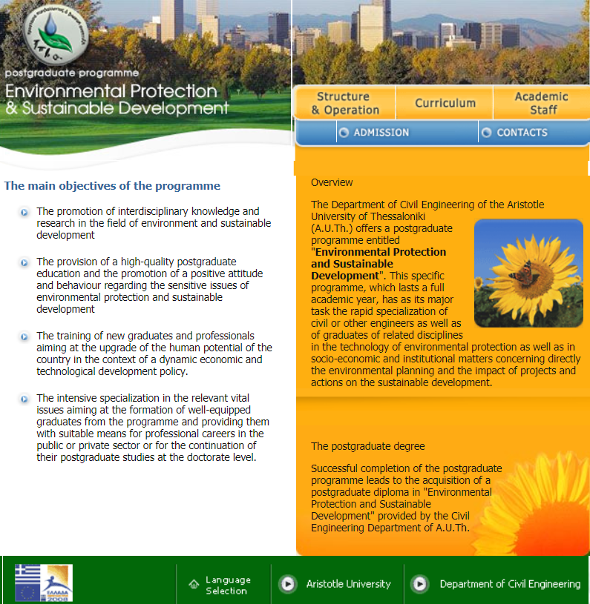
Postgraduate programme at AUTh: Environmental Protection & Sustainable Development
http://ppva.civil.auth.gr/content/en/index.html
Strengthening of master curricula in water resources management
for the Western Balkans HEIs and stakeholders
www.swarm.ni.ac.rs

Slide 12
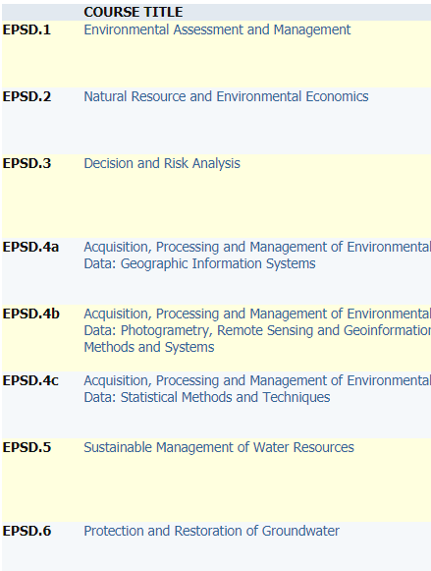
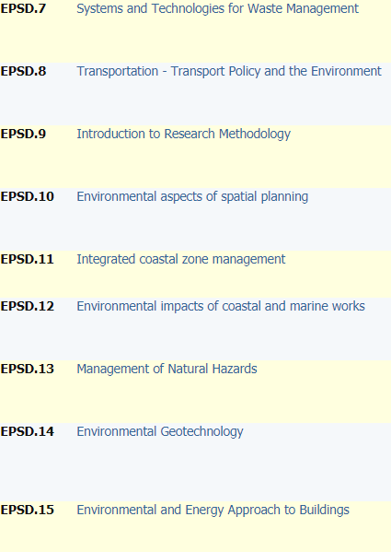
Postgraduate programme at AUTh: Environmental Protection & Sustainable Development
http://ppva.civil.auth.gr/content/en/index.html
Strengthening of master curricula in water resources management
for the Western Balkans HEIs and stakeholders
www.swarm.ni.ac.rs

Slide 13
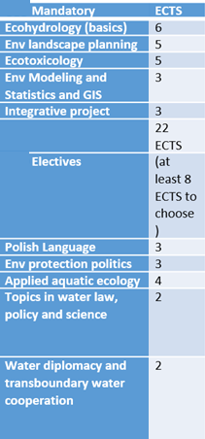
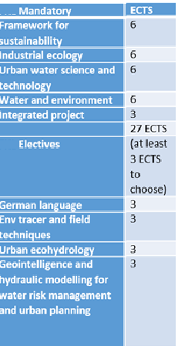
Example of collaborative MSc on Water Resources Management
The proposed MSc is composed in 4 thematics
Ecosystems processes and dynamics
Water engineering and sustainability
Strenthening of master curricula in water resources management
for the Western Balkans HEIs and stakeholders
www.swarm.ni.ac.rs

Slide 14
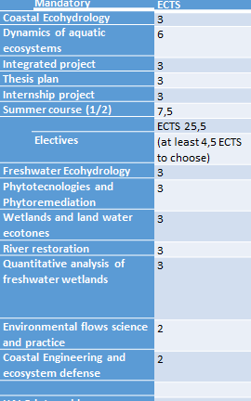
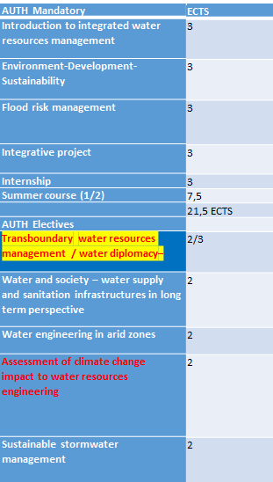
Example of collaborative MSc on Water Resources Management
Ecohydrology & nature based solutions
Water Management and Governance
Strengthening of master curricula in water resources management
for the Western Balkans HEIs and stakeholders
www.swarm.ni.ac.rs

